Slide 1

KALERWE
S.D.A Hymnal 207
4 ~ Verses
163.
Oba Ekiseera Kirituuka Ku Nkya…
~
It May Be At Morn…

Slide 2

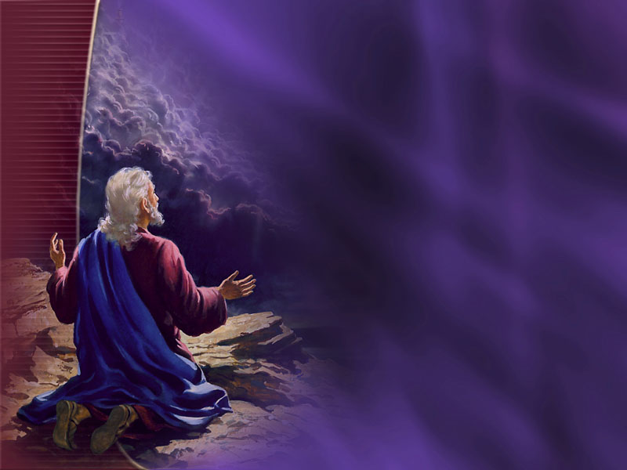
1 of 4 verses
Oba ekiseera kirituuka ku nkya
Okumasamasa kwe ne kulabika;
Yesu ng’ajja n’ekitiibwa ekinene
Okututwala ewuwe.

Slide 3
Chorus:
Ayi Mukama, olijja ddi?
Tulabe (a)maaso go!
Yesu ajja, Aleruya,
Aleruya! Amina.
Aleruya! Amina.

Slide 4
2 of 4 verses
Buliba mu ttuntu oba kawungezi,
Tuliba tuli (a)wo ng’ensi yonna, yonna;
Effuuka omusana ogwaka ennyo,
Mukama ng’atuddukide.

Slide 5
Chorus:
Ayi Mukama, olijja ddi?
Tulabe (a)maaso go!
Yesu ajja, Aleruya,
Aleruya! Amina.
Aleruya! Amina.

Slide 6
3 of 4 verses
Bamalayika ne bayimba n’essanyu,
Era n’abanunule be bonna wamu
N’ekitiibwa kye
ekyakayakan(a) ennyo,
Mukama bw’alijja bw’atyo.

Slide 7
Chorus:
Ayi Mukama, olijja ddi?
Tulabe (a)maaso go!
Yesu ajja, Aleruya,
Aleruya! Amina.
Aleruya! Amina.

Slide 8
4 of 4 verses
Tuligenda n’essanyu eteri kufa,
Teri ndwade, teri nnaku, teri ntisa;
Tuliyita mu bire wamu ne Yesu
Ng’atutwala ffe e-wuwe.

Slide 9
Chorus:
Ayi Mukama, olijja ddi?
Tulabe (a)maaso go!
Yesu ajja, Aleruya,
Aleruya! Amina.
Aleruya! Amina.

